Slide 1
SOFWIC ‘15 Agenda
General Session (Salon D & E)
Welcome/Admin Mr. Karl “Rock” Rozelsky 0800 - 0805
Welcome Mr. James Smith 0805 – 0815
Science & Technology Mr. Tony Davis 0815 – 0835
Small Business Innovative Research Ms. Bonnie Heet 0835 – 0845
Technology Industrial Liaison Office Ms. Shelvin Watts 0845 – 0850
Tactical Assault Light Operator Suit CAPT Anthony Baker 0850 – 0910
PEO SOF Warrior PM Introductions COL John Reim 0910 – 0930
Open Discussions w/SOF Warrior PM’s ALL 0930 – 1130
LUNCH 1130 – 1300
Selected Collaborative Sessions Per Posted Schedule 1300 – 1700

Slide 2
General Session
Collaboration Rooms
Engagement
Area
TILO
TALOS
UPDATE FOR MARRIOTT
S&T
SBIR
Registration
TALOS
SBIR
TILO
Collaboration Rooms
Breakout Room #6 – Regency Room is located on Level 2

Slide 3
ALL DISCUSSION TODAY WILL BE UNCLASSIFIED!!!!

Slide 4
SOF AT&L
Special Operations Forces
Acquisition, Technology, & Logistics
Mr. James Smith
Deputy Director for Acquisition

Slide 5
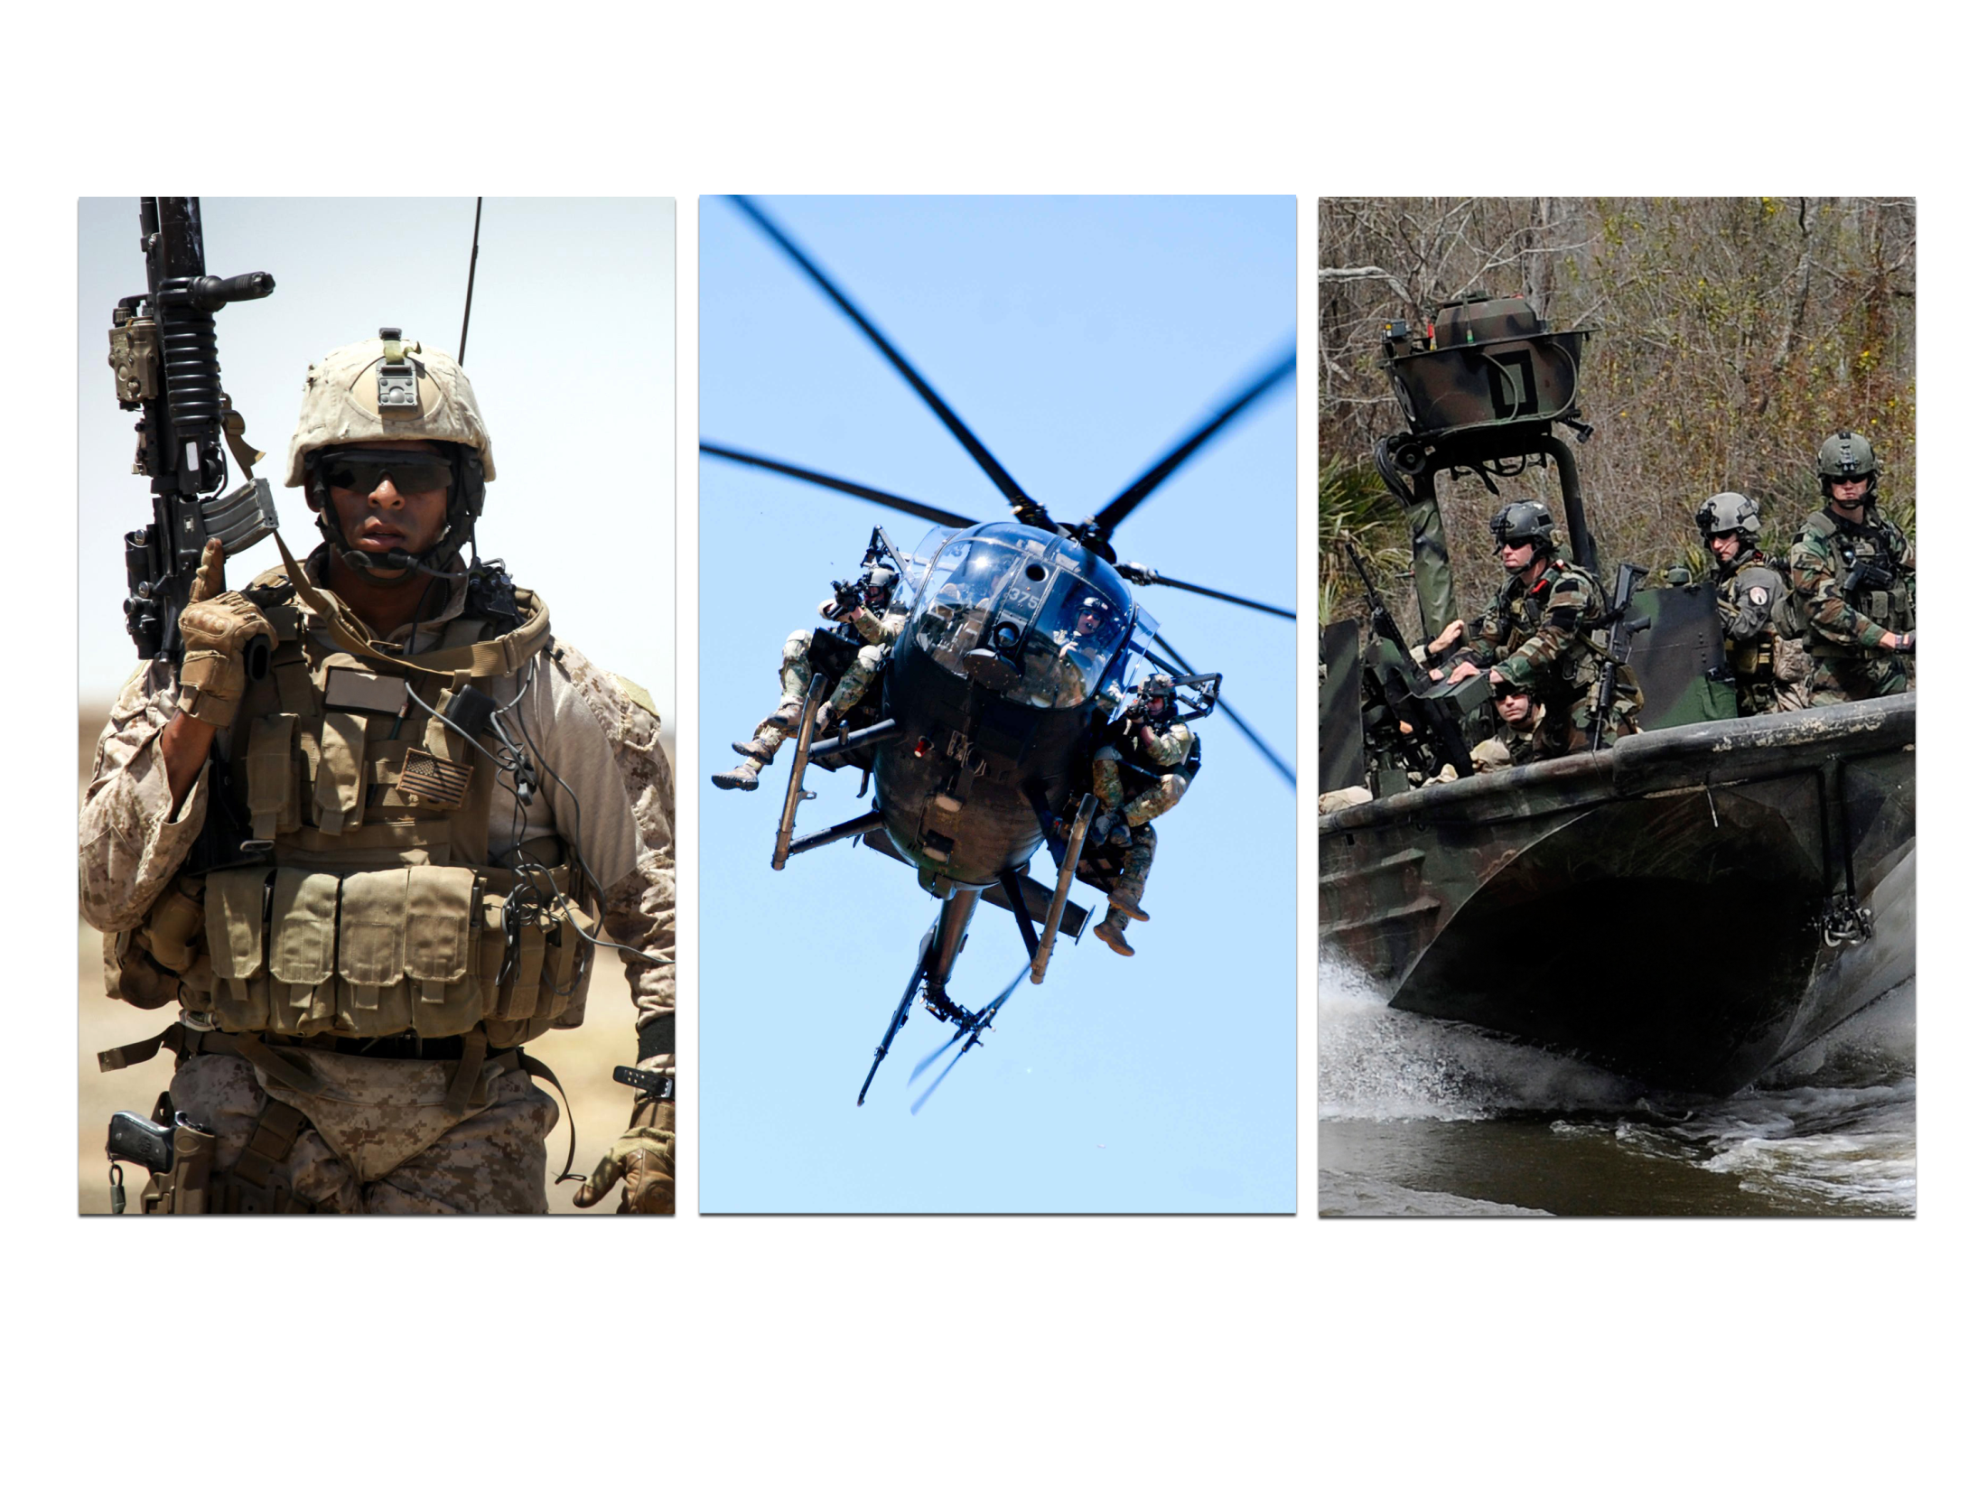
SOF AT&L
MISSION
VISION
PRINCIPLES
Provide rapid and focused acquisition, technology,
and logistics to Special Operations Forces
Be the recognized expert
and trusted provider to
equip and sustain Special Operations Forces
Deliver capability to user expeditiously; exploit proven techniques and methods;
keep Warfighters involved throughout process; take
risk and manage it!

Slide 6
FY15 Acquisition
SOF ACQUISITION TEAM
~600 personnel
INNOVATION
International commercial classification for use of high energy Li-Ion batteries in manned submersibles
Low cost/expendable satellites
Improved tactical combat casualty care
Target engagement weapons/systems
Advanced armor/materials
Low Visibility/LPI C4 systems
Deployable Rapid DNA Analysis
Manned/unmanned ISR
SOF-unique night vision
Coalition partners data sharing
exercise participation
Tactical Assault Light Operator Suit
ANNUAL SCOPE
500+ programs/projects
Oversaw $7.9B
Awarded $3.4B
11,528 contract actions (inc 4,456 actions for services for $1.85B)
98M Rounds of ammunition
42,334 Weapons, accessories, lasers, & visual
augmentation systems
1,874 Operator survival/equipment items
4,909 Radios, SATCOM terminals, & ancillary equipment
28,590 Information Technology automation devices & systems
2,187 Operator & Medic kits
1537* Field Service Reps placed on contract *
(provided to support USSOCOM via PEO SOFSA)
2,455 ISR kits
627 Vehicles
2,769 TACLAN FoS equipment deliveries
13 SCAMPI node, SOCOM Strategic Entry Point, & media ports
313 CASEVAC kits
84 Rotary Wing aircraft & systems
16 Tactical MISO systems
29 Fixed Wing aircraft
12 Mobile Technology and Repair Centers deployed
8 Maritime Surface Crafts
3 Undersea Manned Submersible Prototypes
Notes:
Decrease in Operator survivable/equipment items due to lack of OCO funding

Slide 7
Competition Trends
Competitive Landscape

Slide 8
Small Business Program
FY14 ($M) 667.7 173.5 79.9 230.4 12.8
FY15 ($M) 905.0 287.6 124.5 294.9 62.8
Reporting Through 30 Sep 15
2015 CAOC Small Business Award Winner

Slide 9

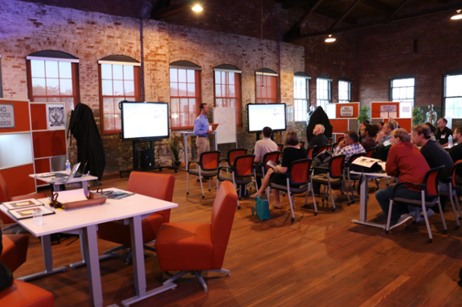
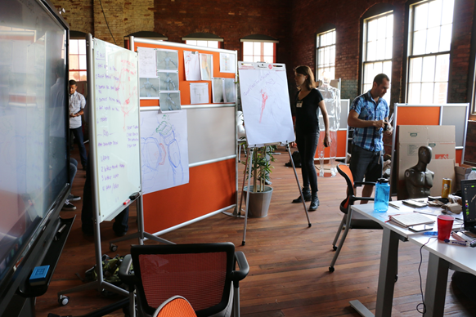
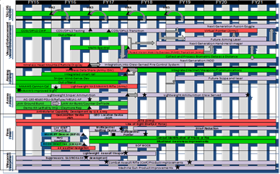
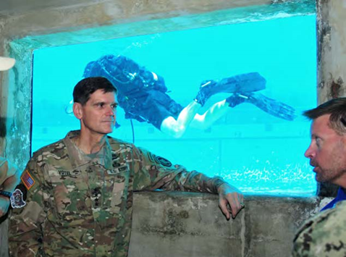


Enabled by Tools
UNCLASSIFIED
Project Vulcan
Turn Everyone into a Sensor
SOFWERX
Create Venues for “Return on Collisions”
Needs
S&T Council
Voice of Components/TSOCs
Technology
Capital
Technical
Experimentation
SOFIC
TILO 2.0
PEO Technology Insertion Roadmaps
Link What Components
Need to Execution
Industry Engagement
UNCLASSIFIED

Slide 10







Breaking Down Barriers
TILO 2.0
Prize
Challenges
TALOS
CRADA
SBIRs
SOFWERX
Industry Visits w/AE
PEO
Industry Days
Experimentation
Non-FAR
Contracts (OTAs)

Slide 11
BACKUP

Slide 12
SOF WARRIOR INDUSTRY COLLABORATION
Mr. Tony Davis
Director
SCIENCE AND TECHNOLOGY

Slide 13
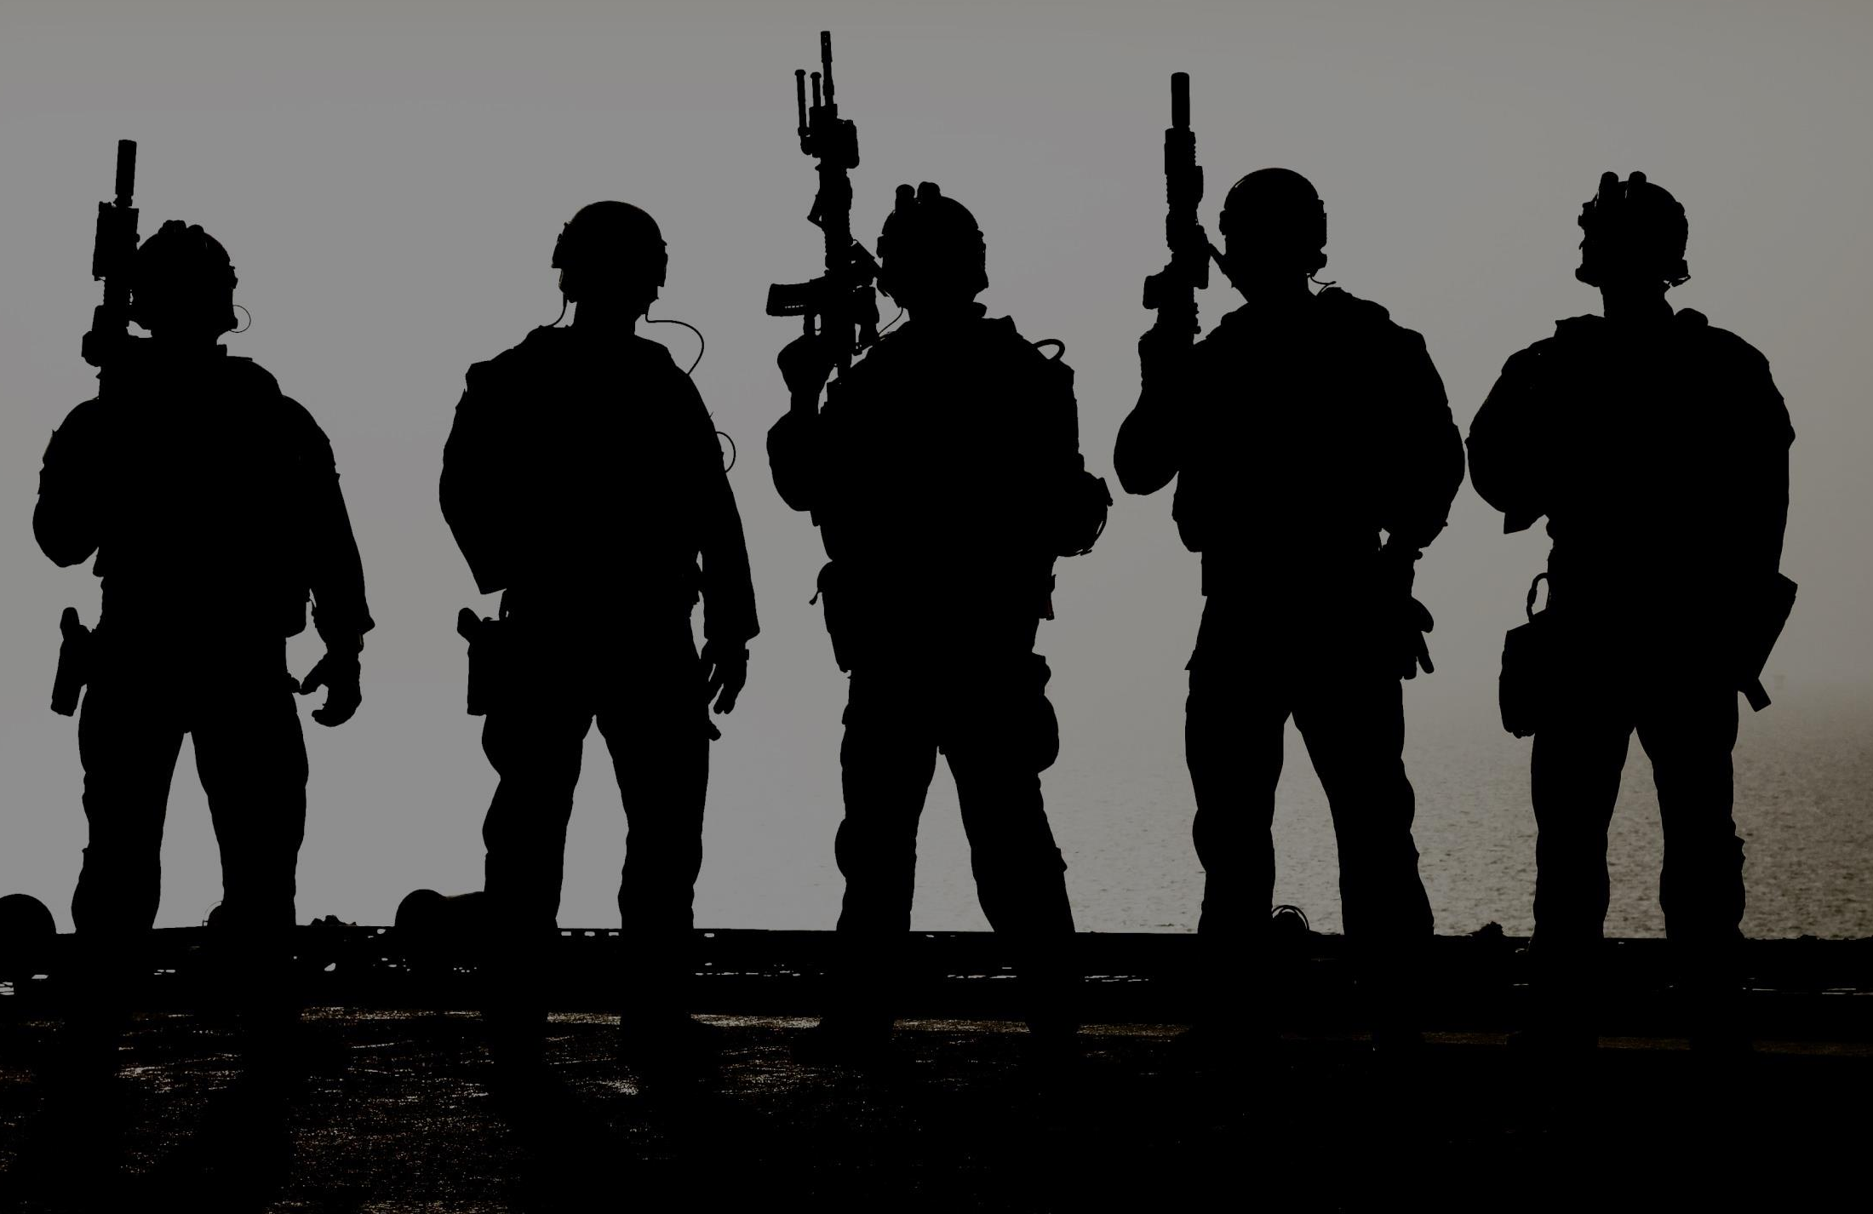
S&T VISION
Discover, Enable, and Transition technologies
to provide an asymmetric advantage for
Special Operations Forces
Notes:
Slightly revised SOCOM S&T vision
Three verbs, Discover, Enable, and Transition specifically chosen to characterize our major lines of operation.
Key distinction is Enable vs. Develop. Due to the SOCOM’s relatively sparse S&T (BA2/BA3) funding profile, we’re putting much more emphasis on influencing the R&D investment in government, industry, and academia to focus on SOCOM gaps, and less on our direct investment.
Next major change was asymmetric advantage to focus our efforts more on the outcome than on specific technologies or capabilities

Slide 14
S&T STRATEGY OVERVIEW
Understand Gaps
Understand Technology
Develop Solutions
Technology
Gaps
Discover
Scouting
Enable
Internal Projects
Roadmaps
Red Team
External Projects
Studies
Transition
PEOs
Military Services
Enablers, COI, OGA, DoD
Deliver
“Game Changing” Technology
Component & TSOC Gaps
Maximize Leverage (DoD, Industry, Academia, Partner Nations)
V I S I ON
PEO
Gaps
Execute
Planned
Transitions
Threat-Related
Gaps
Involve Warfighters
Increase Speed
Manage Risk
Notes:
This is a one page overview of our S&T strategy
From top to bottom, first our overarching strategy is Understand Gaps, Understand Technology, and Develop Solutions
On the middle left you see our decomposition of the type of gaps we’re working to understand, document, and pursue
Previously S&T had been focused on the first two, technology gaps—gaps based on our evaluation of where technology is headed, and when it might be ready/useful for SOF; and Component & TSOC gaps—SOCOM has developed a relatively robust mechanism for understanding these gaps, we have 7 Technology Development Working Groups that meet at least monthly to discuss/evaluate/plan/monitor technologies. These TDWGs are our primary mechanism to (1) understand your gaps, (2) document and prioritize them; and (3) evaluate industry BAA proposals, and recommend our final candidates for investment to the S&T Council for approval. The S&T Council has been chartered for just over a year, and is your (the Components and TSOCs) voice in execution of the S&T portfolio. This voice is louder from some components than others, as the membership runs a spectrum from several dedicated representatives in some Components to one or less part time representative in some of the TSOCs.
A recent addition is the focus on PEO gaps. The Acquisition executive has directed each of the PEOs to develop technology roadmaps, roadmaps that decompose their capability (platform) roadmaps into individual technologies, and outline when they are needed, and areas for potential investment of R&D in order to burn down the risk in a particular technology. Each of the TDWGs have been tasked with analyzing these roadmaps, and developing specific plans for guiding our investment in their portfolio technology area to meet the roadmap gaps.
Last, in red is a renewed focus on threat-related gaps. This is focused on red team type of understanding of the technology focus and investment of our current and future adversaries in order to focus our technology development on areas that they may be reducing our asymmetric advantage.
In the middle you see our three main lines of operation, Discover, Enable, and Transition; with each broken into a further level of detail
Discover is broken into tech scouting, previously our main focus area in discovery; but now supported by our PEO roadmap efforts and red team information on threat-related gaps. In addition, we’ve added a second hat to each of our TDWG leads, and asked them to ensure they are the technical expert in their portfolio area, and support our efforts to do tech scouting in that portfolio.
Enable is broken down into internal projects, external projects, and studies; these are broad categories, but intended to capture our direct investment, indirect investment on our behalf, and conceptual work with industry, government labs, and others to further understand technologies or their application (studies)
For purposes of comparison, in FY14 S&T had approximately $50M (including TALOS) of BA2/BA3 funding to allocate to internal projects, this was supported by direct investment of nearly $27M by external entities on projects to address SOF gaps and requirements
Last, but not least, is transition. Previously not a focus area for S&T, but added recently to recognize that while we have somewhat limited resources, the PEOs have 80% of the Command’s R&D $s ($410M of BA7), and more than $4B of Procurement funding—SOCOM’s primary capability to purchase and deliver kit. In recognition of this, we’ve added a third hat to our workforce, providing one dedicated S&T rep per PEO to be our focal point for communication and understanding of the PEO’s roadmaps, technology gaps, and potential transition points. We’ve also added a page to our portal that outlines each project (currently ~70), the PEO we plan to transition it to, the FY for the transition, and the PM who is working to catch it.
At the bottom you see primary emphasis areas across the different lines of operation; Involve the Warfighter, Increase Speed, and Accept but Manage Risk
Budget Breakdown (FY15):
U.S. $465B
Industry $307B (66%), Federal $123B (26.4%)
DoD $63.5B (51.6% of Federal R&D)
SOCOM $508M (0.8% of DoD R&D)
S&T $97.4M (19.1% of SOCOM R&D)

Slide 15





















INDUSTRY ENGAGEMENT
Tactical Assault Light Operator Suit (TALOS)
Technology & Industry Liaison Office (TILO)
tilo@socom.mil
Technical Experimentation (TE)
Unclassified Test Bed (UTB)
Component Exercises
SOF Industry Conference (SOFIC)
SOF Warrior Industry Collaboration Day (SOFWIC)
TE
External Internal
Identify Technology – Provide Feedback – Advance Tech Readiness Level
Project Vulcan
Technology
Domain
Awareness
Industry
IR&D
Outreach
Other Venues
(JIFX,
Ex-ART/TSOA)
Distributed
Combustion
Chambers
Service and
Other COCOM
Exercises
Other Applicable
Conferences

Slide 16
PEO TECHNOLOGY INSERTION
ROADMAPS
  Stabilized Rapid Adaption of Network
  Security and Network Management/Monitoring of Mobile Ad-hoc Network
  Open Standard Airborne ISR Transport Modem
  High definition, 3D & multi-color EO/IR, multiple moving target tracking, FOPEN
  Crew workload reduction, machine intelligent processing/Tactical Flight Mgmt
  Situational awareness with full spectrum threat reduction and counter measures
  105 mm cannon precision guided ammunition and fuses, loitering munitions
  High energy laser, power management, aiming and focus turret
  Multispectral sensor
  Combat ID, IFF to ID friendly and hostile in all environments
  Common Operating Tactical Picture
  Low Probability of Intercept/ Detection Communications
  Wireless Intercom
  Surface System/Active Ride Control
  Maritime Personnel Signature Management Technologies
  Situational Awareness, High Visual/NIR Transmittance Window Films
C4
Fixed
Wing
Maritime
Notes:
PEO C4
Stabilized Rapid Adaption of Network C4 Tactical Comms SR ISS TIRs- Provide for a dynamically changing network state while maintaining abstraction boundaries and security posture. Solution should allow for network segments to reconstitute themselves and continue to operate and coalesce but also achieve the efficiency of centralized network control.
Security and Network Management/Monitoring of Mobile Ad-hoc Network (MANET) C4 Tactical Comms/Transport TIRs- Enable software defined networking use within a MANET. Use of Edge Network devices to centrally manage user edge devices (radios, networks, smartphones) to develop software technology with the ability to manage and monitor those devices at the physical layer.
Open Standard Airborne ISR Transport Modem C4 Transport TIR - Development of a software defined modem that is agnostic to the associated waveforms, source code and modems employed today, and frequency agile to the maximum extent possible. Shall provide the most operational effective and cost efficient for ingesting, backhauling, distributing, and delivering the desired sensor data on a global scale for SOF missions worldwide.
PEO FIXED WING
High definition, 3D and multi-color EO/IR packages to fit in Modular Payloads. This effort is to develop and provide sensors that can be readily configured inside modular payloads for Group IV UASs and manned ISR platforms. Additional payloads include moving target tracking, foliage penetration, medium and wide area motion imagery.
Crew workload reduction, machine intelligent processing and Tactical Flight Management (TFM) Development for a system that automates crew workload, shares complex data and improves situational awareness and decision making abilities for the crew. The objective is to maximize the capacity of limited platforms or small ground team to detect and understand humanly indiscernible objects and contextual relationships that allow for workload reduction.
Situational awareness with full spectrum threat reduction and counter measures. Manned aircraft survivability function includes signature management in the areas of acoustics, radio frequency (RF), and infrared (IR) bands. Technologies of interest are: low signature communications and antennas, GPS-degraded operations, VTOL threat suppression, and mission networking and awareness.
105 mm cannon precision guided ammunition and fuses and loitering munitions. Development of guided munitions that provide wide range of desired lethal and non-lethal effect, have demonstrated better accuracy and lethality with reduced size weight and power and reduce overall life cycle costs.
High energy laser, power management, aiming and focus turret. This technology is intended to demonstrate the capability of operationally effective Directed Energy (DE) weapons to establish engineering and airworthiness criteria for testing and fielding. Additionally, it will help develop the CONOPS and employment for DE that provides a range of offensive and defensive desired effects.
Multispectral sensor - There is a need to increase current capabilities to include multiple colors or spectral bands within the same sensor and SWAP.
Combat ID (CID) - There is a need for an Identify Friend or Foe (IFF) beacon for ground soldier that is backwards compatible with existing equipment.
PEO MARITIME
Common Operating Tactical Picture M-Surface TIR - Ability to provide real-time correlation and fusion from disparate sensor feeds such as: IBS, AIS, RADAR (T); BFT, ELINT, SIGINT, IFF (O).
Low Probability of Intercept/ Detection Communications M-Surface TIR- Conduct secure low observable and low detectability communications on maritime surface crafts.
Wireless Intercom M-Surface TIR- Incorporate wireless, non-Type 1 intercom on maritime surface crafts (T); Wireless Type 1 (O).
Surface System/ Active Ride Control M Surface TIR- Passive seat shock absorption techniques. High-energy hydraulics (for rapid trim-tab actuation) Sed(8) < 4.7 MPa (T), Sed(8) < 3.9 MPa (O).
Maritime Personnel Signature Management Technologies M Surface TIR- Ability to reduce detectability of crew on surface craft (T); plus No degradation in human performance (O).
Situational Awareness, High Visual/NIR Transmittance Window Films M Surface TIR - Provide RF shielding and NVG capability for improved high visual situational awareness/ near infra-red transmittance window films on maritime surface crafts.

Slide 17
PEO TECHNOLOGY INSERTION
ROADMAPS (2)
Rotary
Wing
  High Power Watts for Over the Horizon Communications
  Improved RW Counter Measures
  Advanced IR Countermeasures & Self-Protection for RW Aircraft
  Maritime Forensics Exploitation Capability
  Hidden Chamber/Material Detection
  Portable, Automated 3D Room/Building Mapping Device
  Stand-off/Remote Facial Recognition & Iris Capture
  Dustless Latent Print Collection
  Rapid Identification of Materials for Site Exploitation
  Transferrable armor for commercial vehicles
  Helmet sensor system to monitor and record linear and rotational accelerations
  High Sulfur Diesel Engine Capability
  Camouflage Applique
  Reduced IR Signature
  Improved Gun Barrels
  Variable Transmission & Laser Protection Eyewear
  Tactical stand-alone ballistic plate
  Multiple colors or spectral bands within the same sensor and SWAP
  Thermal band Identify Friend or Foe (IFF) beacon, backwards compatible
SRSE
SOF
Warrior
Notes:
PEO RW
High Power Watts (HPW) RW TIR- Over the horizon (OTH) communication system to augment/ reduce dependency on SATCOM.
Improved RW Counter Measures RW TIR- Improved survivability against current and emerging threats.
Advanced IR Countermeasures & Self - Protection for RW Application RW TIR - Develop Operationally suitable IRCM components to defeat advanced threats Integrated Hostile-fire Indication.
PEO SRSE
Maritime Forensics Exploitation Capability - Rapidly process & exploit biometric, forensics, documents/electronic media, and chemical samples in politically sensitive and denied areas
Hidden Chamber and Hidden Material Detection - Body worn or handheld device to detect concealed compartments, chambers, or materials
Portable, Automated 3D Room/Building Mapping Device- Collection and processing of physical information obtained at target locations for exploitation and re generation.
Stand-off/Remote Facial Recognition & Iris Capture & Dustless Latent Print Collection - Technologies used to collect, analyze and distribute various physical parameters that can be used to identify personnel. Small form factor that provide the capability to rapidly (< 2 min) identify personnel, reduce false alarm rates and/or offer novel approaches at short to long distances in all environmental conditions
Dustless Latent Print Collection
Rapid Identification of Materials for Site Exploitation - Body worn system to detect, identify, and visually locate exposed chemical, biological, radiological, or explosive materials inside a building
PEO SW
Transferrable armor for commercial vehicles - USSOCOM desires a modularly-configured vehicle armor to temporarily provide a commercial vehicle with various levels of ballistic protection. The protection package (transparent and opaque armor) shall be transferable between like vehicles (e.g.: truck to truck, Sport Utility Vehicle (SUV) to SUV, sedan to sedan), easily installed / removed, shall maintain the vehicle’s original exterior and interior OEM appearance and shall not significantly degrade vehicle performance. The armor package should provide protection to the main occupant areas (windows, doors, floor, and roof). Successful solutions will highlight the manufacturing and operational-level installation processes and describe/illustrate system enhancements in terms of managing weight, space, cost, visual signature, threat ballistic performance and functionality.
Helmet sensor system to monitor and record linear and rotational accelerations -A helmet sensor system integrated directly into the helmet pads, residing on, or immediately adjacent to, the user's head. Sensor system would be deployed in theater with the user to monitor and record the linear and rotational accelerations (x,y,z axis) to the user's head in both the blunt impact and higher frequency vibration regimes. System shall be seamlessly integrated so as to not interfere with the user's normal functions nor be uncomfortable to the user. Power source shall not have a fire or chemical risk to the user, nor cause overheating in the helmet, and should be able to power the device for multiple days (at a minimum) without recharge. Device shall have sufficient onboard storage to record multiple impact/vibration events, and should easily transfer data to a personal computer (via USB or other simple protocol) in a common file format such as .csv.
High Sulfur Diesel Engine Capability for GMV 1.1 SW MobilityTIR - A modification to the current GMV 1.1 engine and its emission system to support the use of high sulfur JP-8 fuel.
Camouflage Applique SW MobilityTIR - Seeking solutions aimed at hiding vehicles with respect to visual signature by providing appliqués that cover the vehicle, but allow quick transition to movement, perhaps culminating in appliqués that perform the same function while being integral or integrated into the vehicle.
Reduced IR Signature for GMV 1.1 SW MobilityTIR - Effort to shield, hide or disburse the thermal and IR signatures on GMV 1.1 and other SOF platforms.
Improved Gun Barrels SW Lethality TIR- Operate and Maintain Weapons at an Operational Availability of 98% through the Range of Specific Conditions Weapon System reliability ≥.94 Probability of No Class I or II Failures and ≥.97 Probability of No Class III Failures per OMS/MP. Advanced barrel designs, materials, and manufacturing technologies to create machine gun barrels that are lighter, with higher sustained rates of fire, longer barrel life. Sniper barrels that are lightweight, long barrel life, and extremely accuracy
Variable Transmission & Laser Protection Eyewear (Eclipse Proposal) SW Survivability IE/Tac MedTIR.
Tactical stand-alone ballistic plate SW Survivability IE/Tac MedTIR- A ballistic plate able to defeat one shot of 7.62x51mm M993 (at a velocity of 3050-3100 feet per second) and one shot of 7.62x54R API (at a velocity of 2850-2900 feet per second) with a back face deformation of less than 44.0 millimeters. The armor system shall be no more than 7.2 pounds per square feet (Threshold), or 6.8 pounds per square feet (Objective).
Multiple colors or spectral bands within the same sensor and SWAP
Thermal band Identify Friend or Foe (IFF) beacon, backwards compatible

Slide 18
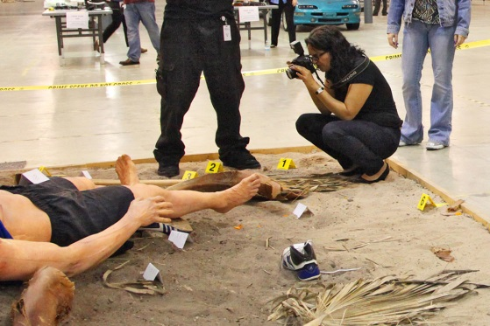
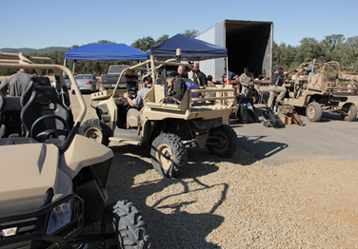
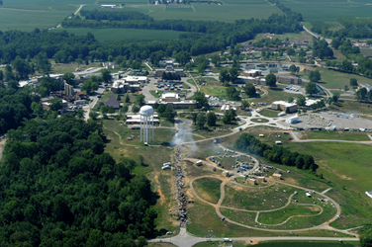
TECHNICAL EXPERIMENTATION (TE)
TE 16-1 30 Nov – 4 Dec, 2015, National Forensic Science Technology Center, Florida
  Experimentation Focus: Combat Medicine and Sensitive Site Exploitation
TE 16-2, 7-11 Mar, 2016, Camp Roberts, California
  Experimentation Focus: C4 and Mobility
TE 16-3, 11-15 Jul, 2016, Atterbury-Muscatatuck Center for Complex Operations, Indiana
  Experiment Focus: Unconventional Warfare / Urban Operations
TE USSOCOM Public Link:
  http://www.socom.mil/sordac/Pages/ExpWithUS.aspx
LinkedIn Group:
SOCOM Technical Experimentation

Slide 19
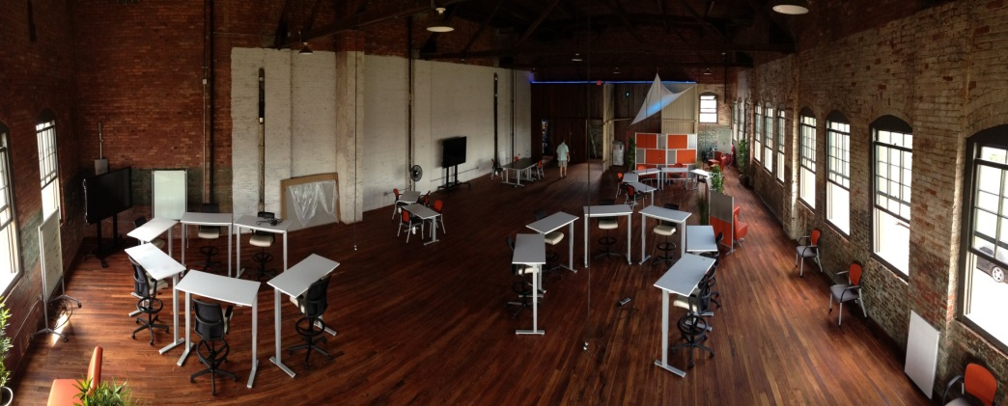



SOFWERX
Promote industry engagement
Conduct rapid innovation and design thinking sessions with government, academia, and industry experts
Host technology sprints to rapidly overcome hard to solve problems
Conduct rapid prototyping session to build out ideas and designs and better inform future builds and engineering decisions

Slide 20

COOPERATIVE R&D
AGREEMENTS (CRADAs)
A CRADA is:
  A legal agreement for Research, Development, Test, & Evaluation (RDT&E)
  A collaborative effort with non-federal party (parties)
  Parties may provide and share personnel, services, facilities, equipment, or other resources in conducting the RDT&E
  Non-federal party may also provide funds; statute prohibits government from providing funds to non-federal party
  Since collaborating party does not receive federal funds, normal government procurement requirements do not apply
  End objective – advance Science and Technology that meets USSOCOM mission requirements but also has viability in other potential commercial applications

Slide 21
TWO DISTINCT CRADAs
FOR SOF AT&L
  OVERARCHING CRADA
    Formulated to provide general access to gaps and needs to foster collaboration
    SOF AT&L AE signed – Company coordination and acceptance – generally 30 days
    CRADA allows for formulation & execution of Joint/Individual Work Plans (JWP/IWPs) between the Collaborator(s) and any PEO/ Directorate within SOF AT&L
    JWPs/IWPs staffed, approved, and signed - Target 30 days for staffing
    Collaborator(s) may request meetings to begin JWP/IWP development
  SPECIFIC
  (TRADITIONAL) CRADA
    Formulated to provide a collaboration on a specific technology
    Follows USSOCOM D70-1, Appendix Q procedures
    Standard template
    Specifically between Collaborator and single PEO/Directorate
    Writing and staffing is generally 90 - 120 days

Slide 22
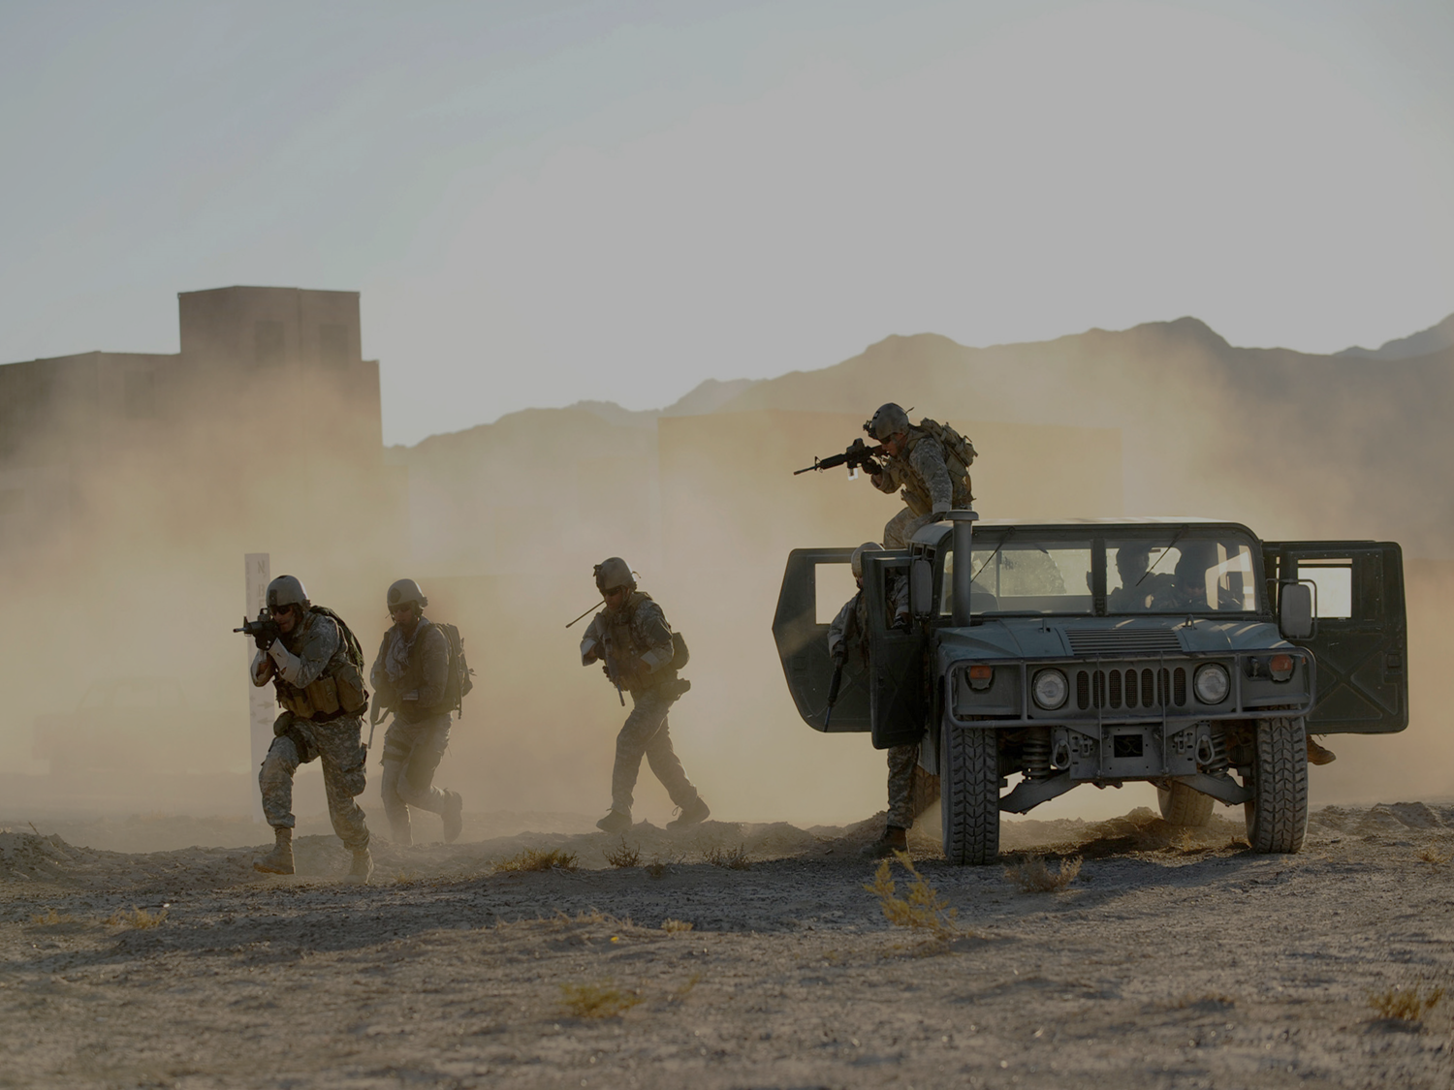

UNCLASSIFIED
QUESTIONS?
Email: anthony.davis@socom.mil
Twitter: @tonydavis_st
LinkedIn: www.linkedin.com/in/tonydavisst
UNCLASSIFIED

Slide 23
SOF WARRIOR INDUSTRY COLLABORATION
Bonny Heet
USSOCOM
Small Business Innovation Research/
Small Business Technology Transfer
Program Manager

Slide 24
SBIR Objectives
Stimulate technological innovation
Increase private sector commercialization of federal research and development
Increase small business participation in federally funded research and development
Foster participation by minority/disadvantage firms in technological innovation

Slide 25
SBIR Three—Phased Approach
The beginning
Phase I
The journey
Phase II
The new beginning
Phase III
Early Exploration of Ideas
Feasibility Study
Up to $150K
Concept Refinement
Prototype Development
Typically $1M
Further R&D/ Demonstration
Production & Sales

Slide 27
SBIR Links
USSOCOM SBIR Program: www.ussocomsbir.com
DoD SBIR program (managed by OSBP): https://sbir.defensebusiness.org/
Federal SBIR Program (managed by SBA): www.sbir.gov

Slide 28
SBIR Contacts
Bonny Heet
SBIR PM
Thomas Piazza
(Support Contractor)
SBIR Analyst
SBIR@SOCOM.MIL

Slide 29
Technology & Industry Liaison Office (TILO) Mission Brief
Ms. Shelvin Watts
Program Support Specialist
22 Oct 2015

Slide 30
TILO Mission
The primary contact for the command and industry, academia and other Government agencies to facilitate communications, connections and collaboration of SOF capabilities, ideas and solutions to command interest areas.
  Technical discussions, demonstrations, presentations and other events are conducted through the TILO to conduct market analysis, analysis of alternative solutions, and other decision making processes
  Industry is provided guidance, direction and assistance on how to conduct business with SOCOM

Slide 31
TILO MISCONCEPTIONS
We have a large support staff
We are part of contracting
We influence requirements
We only support SOF AT&L
Retired GOFOs get special treatment
TILO is the only way to contact SOCOM
All we do is schedule meetings
We determine if a contractor’s idea moves forward…

Slide 32
WHAT IS THE PROCESS
SOCOM advertises Areas of Industry on Webpage
Industry submits white paper
TILO makes first assessment, determines review
SME’s provide feedback
Meetings/Demos can be set up
TILO coordinates the logistics, advertises, etc.
Provides feedback to industry at conclusion
Up to SME’s/attendees to make determination of next step
Referral to SITEC, GBPS, etc.
Linked to TE, SBIR, BAAs, etc.

Slide 33
SUBMIT YOUR IDEA
Provide a solution, not a generic capabilities overview
Understand what is “SOF”, and what is “Service” Common
  Defined as “Equipment, material, supplies and services required for which there is no Service-common requirement".
  These are limited to items and services initially designed for or used by SOF until adopted for Service-common use by other DoD forces, modifications approved by the Commander for application to standard items and services used by other DoD forces;
  Items and services which the Commander approves as critically urgent for the immediate accomplishment of the SOF activity.
Provide enough technical information for a subject matter expert to understand your capability

Slide 34
PROCESS BENEFITS
SOCOM communicates approved technology/capability areas of interest on website
SOCOM receives targeted information focused on specific areas of interest
Industry capabilities are reviewed by subject matter experts within the command
All contractors go through same process
Briefing material and all contact information retained by TILO for future use/collaboration available to all SOCOM personnel

Slide 35
WHO DO I CONTACT
ACQUISITION
ACQUISITION
All submittals MUST go through the webpage
If you have questions or issues:
    Ms Shelvin Watts
    TILO Program Support Specialist
    813.826.9482
    tilo@socom.mil
    Christopher Harrington
    Director, Small Business Programs & TILO
    813.826.9475

Slide 36
Tactical Assault Light Operator Suit (TALOS)
SOFWIC
22 OCT 2015
V5.0

Slide 37
Overview
Aug’13, SOCOM Commander initiated a vision for a next generation , technologically advanced combat operator suit (TALOS) to better protect SOF operators conducting high-risk missions
SOCOM must harness technology to achieve this
  Enhanced survivability
  Dominant situational awareness
Ambitious acquisition vision (first prototype NLT Aug ‘18)
  Established Joint Acquisition Task Force (Nov’13)
  Pioneering Innovative Processes
    Rapid prototyping, Prize Challenges, blanket CRADA
  Challenge to industry/academia

Slide 38
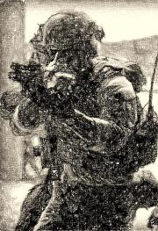
TALOS Priorities
Combat Suit Development
Novel Research and Development of emerging / disruptive technologies;
Ongoing Assessment, Test, and Integration of multiple sub-systems and tactical components
Accelerate Tech Development / Transitions
Over-the-horizon technology focus; Equipping SOF to win in a complex, uncertain future
Pioneer Innovative Processes
Rapid Prototyping, Prize Challenges, Streamlined Acquisition;
leveraging alternate novel acquisition and development methods
Consistent Collaboration
Maintaining Extended Network, Continuous end-user Engagement;
Forging new relationships with Academia, Industry, Government
TALOS: Protecting the Operator at his most vulnerable moment
“TALOS was chartered to explore and catalyze a revolutionary integration of advanced technology to provide comprehensive ballistic protection, peerless tactical capabilities and ultimately to enhance the strategic effectiveness of the SOF operator of the future.”
--GEN Joseph Votel, USSOCOM Commander

Slide 39


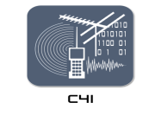
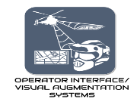
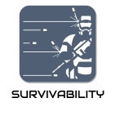
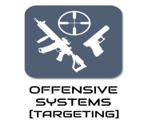


Functional Areas
MOBILITY SYSTEMS
TACTICAL SYSTEMS
Technical Risk:
High Risk
Medium Risk Low Risk

Slide 40
Technology Challenges
Powered Exoskeleton
Man-portable Power Source
Actuators and control theory
Lighter Armor
Latency in Digital Optics
Integration (JATF is lead)

Slide 41
Upcoming Events
12 November 15: Helmet Interface Standards (SWX)
08 December 15: Camera ICDs (SWX)
Mid-January 16: Helmet Sprint on VAS/Computing (SWX)
March 16: Baselayer? (SWX)
TBD: C4I (SWX)
TBD: Software Development (SWX)
TBD: Sensors (SWX)
Spring: Power/Energy (SWX)
May: SOFIC (Tampa Convention Center)
Shifting to steady state prototyping, integration, and collaboration events
at SWX (downtown Tampa facility)

Slide 42
Partnership Opportunities
Broad Agency Announcements (https://www.fbo.gov/)
  Applied Research: Studies, Early Laboratory Hardware, Software Development Models, Concept Exploration: Technology Readiness Level (TRL) 3-5
  Advanced Technology Development Prototypes, Demonstrations, Operational Leap Ahead Capability: TRL 5-7
SOCOM TILO / SOFIC
Prize Challenges
Doolittle Institute (SWX): The USSOCOM's Partnership Intermediary for collaboration with Industry, Academia, and Government

Slide 43
Tactical Assault Light Operator Suit (TALOS)

Slide 44
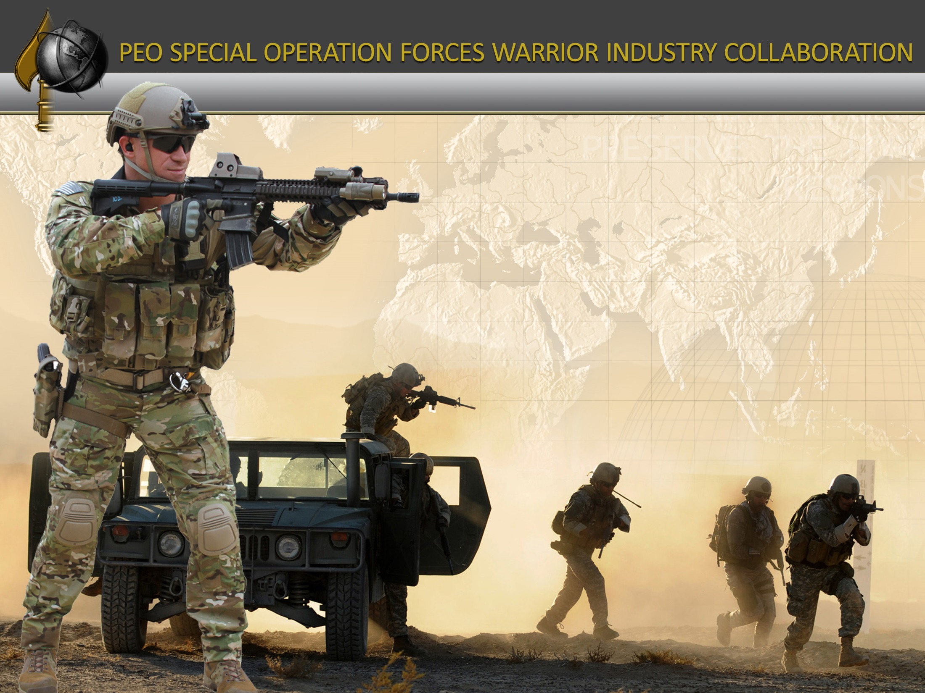

COL John Reim
Program Executive Officer
Acquisition at the Speed of War!

Slide 45

PEO SW Video
Play SW Video
Science & Technology
BAA’s & Experimentation
PM Tech Insertion
Road Maps
SBIR
PEO
Programs/Projects

Slide 46
Why We Organized This Event
Industry | SOCOM need to meet!
Third annual SOFWIC – (6) months post SOFIC
Reinforce industry collaboration w/Special Operations Forces Acquisition, Technology, and Logistics
Plan to continue maturing process; more efficiently target SOF Warrior capability gaps
Will continue semi-annual trend of events
Science & Technology
BAA’s & Experimentation
PM Tech Insertion
Road Maps
SBIR
TIRELESS, DILIGENT, & FEARLESS IN OUR SUPPORT TO SOF!!
PEO
Programs/Projects

Slide 47
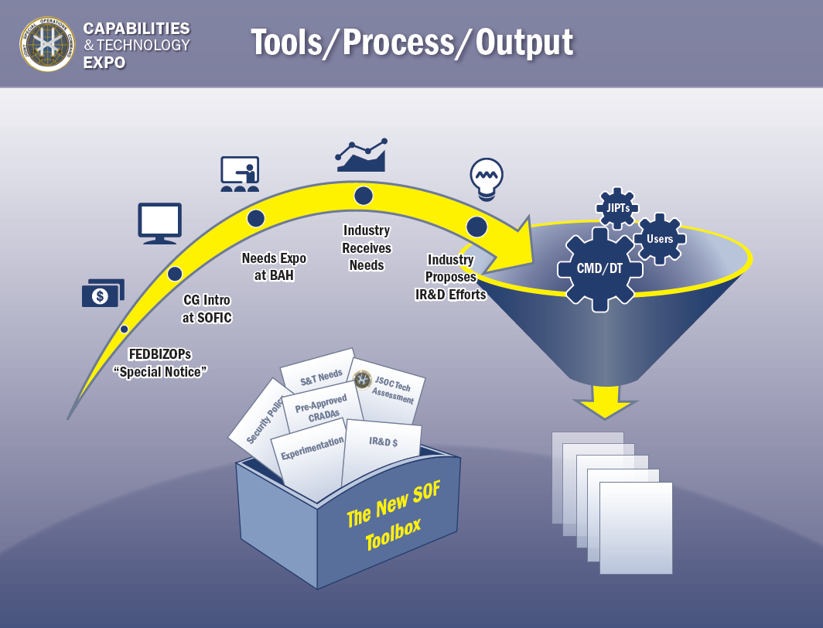
SOFWIC Process
TIR’s @ SOFIC
FedBizOps
SOFWIC
Eval Papers
Objective
  Enhance PEO-SW and Supported Community User Team collaboration with industry in support of the SOF Operator.
  Identify innovative capability solutions that might add enhanced capabilities to the Special Operations Forces (SOF) warfighter.
TAILOR FOR PEO-SW
8 shops
PM’s
CDD’s
S&T
TALOS
Emerging Gaps
OTHER PEOs
SBIRS / CRADA
Combat Eval / Projects
ICD / CDD / CPD - Programs

Slide 48
SOFWIC METRICS
150+ Vendor Submissions received in response to the USSOCOM Special Notice
62 Total white papers selected to brief:
  48 Vendor proposals selected to brief USSOCOM
  14 Vendor proposals selected to brief JSOC on CRADA opportunities
$50.78M Vendor proposed IR&D
$1025.68M total industry investment

Slide 49
METRICS

Slide 50
METRICS

Slide 51




ACCESS TO USSOCOM/SOF AT&L
How to get my “foot” in the door
The Teams
Combat DEV
PEO/PMs
Material DEV
TILO
SBIR
TALOS
Industry

Slide 52
General Session
Collaboration Rooms
Engagement
Area
TILO
TALOS
UPDATE FOR MARRIOTT
S&T
SBIR
Registration
TALOS
SBIR
TILO
Collaboration Rooms
Breakout Room #6 – Regency Room is located on Level 2

Slide 53
General Session
Collaboration Rooms
Engagement
Area
Capability Areas
 | F3EA, ISR
 | Ammo/Demo, VAS, Target Engagement, Weapons System
 | Communications and Information Technology
 | Breaching, Electronic Warfare, and Mobility
 | TCCC & SSES
TILO
TALOS
UPDATE FOR MARRIOTT
S&T
SBIR
Collaboration Rooms

Slide 54
General Session
Collaboration Rooms
Engagement
Area
Time | Room 1 Esquire | Room 2 Promenade | Room 3 Commodore | Room 4 Veranda | Room 5 Kennedy | Room 6 Regency
9:30 AM - 11:30 AM | Open Break Out Sessions | Break Out Sessions | Break Out Sessions | Break Out Sessions | Break Out Sessions | Break Out Sessions
BREAK | BREAK | BREAK | BREAK | BREAK | BREAK | BREAK
1:00PM | L-3 Comm - Panoramic NVG Enhancements | HumanGeo - Realtime Event Detect & Analysis | BAE - Airborne Software For TTL | SRI - Hyperspecteral Taggart Material & Detection | Azimuth - Trigger of Underwater Release | Kforce - K9 Medical Trainer
1:30PM | LaserMax - Dual Out of Band Laser Pointer | Aerojet Rocketdyne - Chemical Enhance Thermal Torch | Northrop Grumman - LIDAR Eval & Adapability Assessment | Fibrotex Technologies - Magic Screen | Northrop Grumman - Adv Underseas Comms For IW | Kforce - Modular Limb
2:00PM | LaserMax - Midwave Beacon | Ascendance Intl - Occupant Protection System | IMSAR - All-Weather ISR MINT | Excivity Inc - Monocle Team SA System with Off Structure Comms | BAH - OTH Comms For UFO | BAE - Standoff Vital Signs
2:30PM | BAE - Covert/GEO NVG Sensors | Ascendance Intl - Heat Mit Suppressor & Config. Handguard | IMSAR LLC - NSP Family Plug N Play ISR | L-3 Comm - APEX Small Tactical FVR Platform | Omnispace LLC - OTH Satellite Comms | W.L Gore - PSM
3:00PM | BAE - Low SWAP-C Covert Digital Night Vision & Covert Laser Use | OREOS - Precision Surveillance & Targeting System | Entropix LLC - Automated SUAS Integrated SIGINT/FMV | Berry Aviation - Roll On/Roll Off ISR | Triple M Consulting - Secure Storage Delay Tolerant Networking | S&S Precision - Smart Manta Strobe
3:30PM | UTAS - Portable Image Blending | General Dynamics - 81mm Airdrop Guided Mortar | Helios - CAPER | Geofeedia - Social Media Intel Platform | Sierra Nevada - Secure Personal Area Network | Sparton - Maritime EW
4:00PM | UTAS - SPS & SWR | Arete - GARVIS | Helios - Soldier Tactical Radar System | ArgonST - VLF PPLI for A2AD Environments | Sierra Nevada - Binary Armor Utilities | BAE - Software Defined Antenna
4:30PM | Northrop Grumman - Precision Target Locator Device | CANCELLED | CANCELLED | Thales - I-Master SAR & Moving Tgt Radar | Hughes - High Bandwith BLOS for Rotary Wing Aircraft | Mistral Inc - Electronically Steered Array
Capability Areas
 |  | F3EA, ISR
 |  | Ammo/Demo, VAS, Target Engagement, Weapons System
 |  | Communications and Information Technology
 |  | Breaching, Electronic Warfare, and Mobility
 |  | TCCC & SSES
TILO
TALOS
UPDATE FOR MARRIOTT
S&T
SBIR
Collaboration Rooms

Slide 55
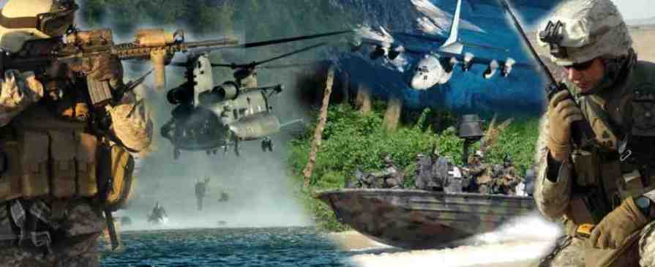
Questions?
55

Slide 56
SOFWIC METRICS

Slide 57
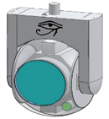
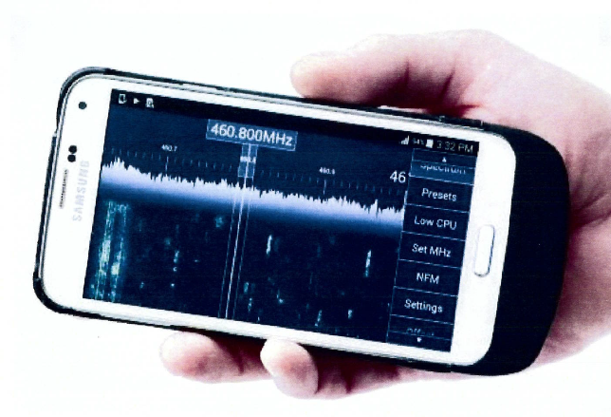
Success Stories
Low Profile Handheld C4I, and ISR/ SIGINT Receiver
Civilian appearance
Spectrum Survey Tool
Encrypted ISR Capable
Current Unit utility
Long Range ISR Ball
4k Resolution
Extreme standoff
Future Enterprise utility

Slide 58
TIMES ARE CHANGING
Yesterday
Declared Theater Active Armed Conflict (DTAAC) Iraq / Afghanistan
DoD / SOCOM Resourced to Win ($$$$)
Overseas Contingency Operating
(OCO) = Norm
Demand – Large Force / High Volume / Specialized
Conferences/Conventions = Industry Collaboration
CBT MSN Need Statements – Fast Requirements
Continuous Fielding Capabilities
(High Volume)
Today
Outside Declared Theater Active Armed Conflict (ODTAAC) Everywhere / TSOC
DoD Resource Constrained ($$)
Base Dollars (O&M Shortages) Impact Investment Dollars
Demand – Capable Force /
Broad Range
DoD Guidance on Travel, attendance
at Conferences/Conventions = Less Uniform in crowd
Requirements / Funding
Sustaining High Volume of Fielded Capability
No Boots on Ground
Train & Equip – SOF Deployed

